Slide 1


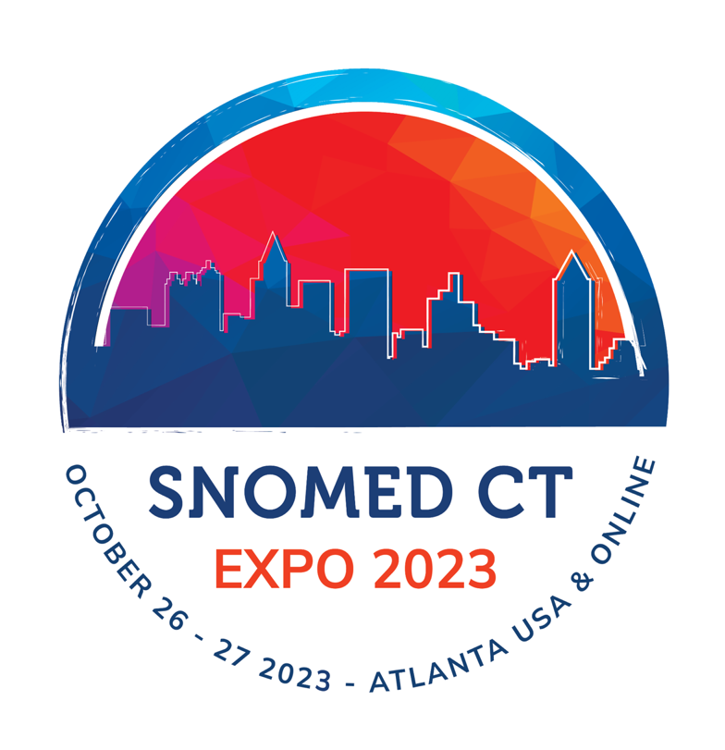
Construction of the Immunization Component of the Brazilian
IPS - (International Patient Summary): mapping of local vaccines
terminologies to SNOMED-IPS
Beatriz de Faria Leao, MD, PhD
This abstract describes the mapping of the Brazilian list of Immunobiologics
to SNOMED IPS, for the construction of the Brazilian International Patient Summary
Global terminology enabling quality information exchange

Slide 2
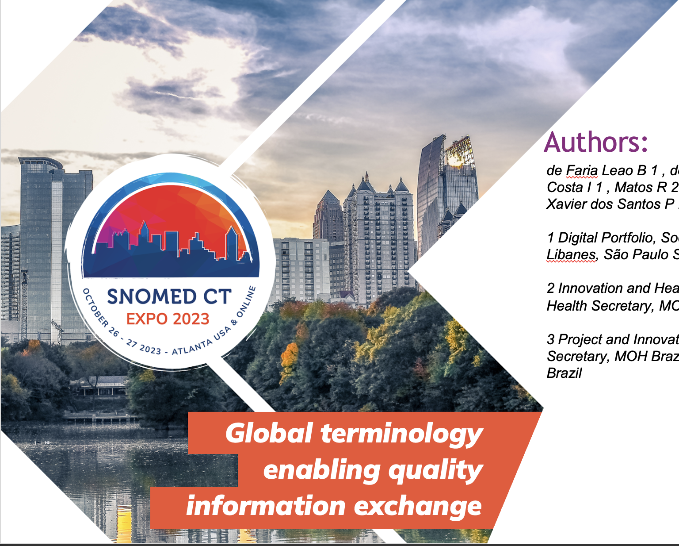
Authors:
de Faria Leao B 1 , de Assis Molla M 1 , Macedo do Amaral Costa I 1 , Matos R 2 , Neves G 2 , Gomes I2 , Gaete R 2 , Xavier dos Santos P 2 , Dalbosco Gadenz S 1
1 Digital Portfolio, Social Commitment Board, Hospital Sirio Libanes, São Paulo SP, Brazil
2 Innovation and Health Informatics Coordination,Digital Health Secretary, MOH Brazil, Brasilia DF, Brazil
3 Project and Innovation Coordination, Primary Care Secretary, MOH Brazil, Brasilia DF,
Brazil
Global terminology enabling quality information exchange

Slide 3
Background
The IPS is an extract of an electronic health record that contains essential health information intended for use in unscheduled and cross-border care settings and could also be used as a national continuity of care document
The development of the Brazilian IPS attends three of the seven strategic axes of the Brazilian Digital Health Strategy (ESD20-28): 3-support for better healthcare delivery; 4- the user as protagonist; 7- connectivity environment.
The IPS-Brazil project is a collaboration between Sírio-Libanês Hospital and the Brazilian Ministry of Health through the Support Program for Institutional Development of the Unified Health System (PROADI-SUS)

Slide 4
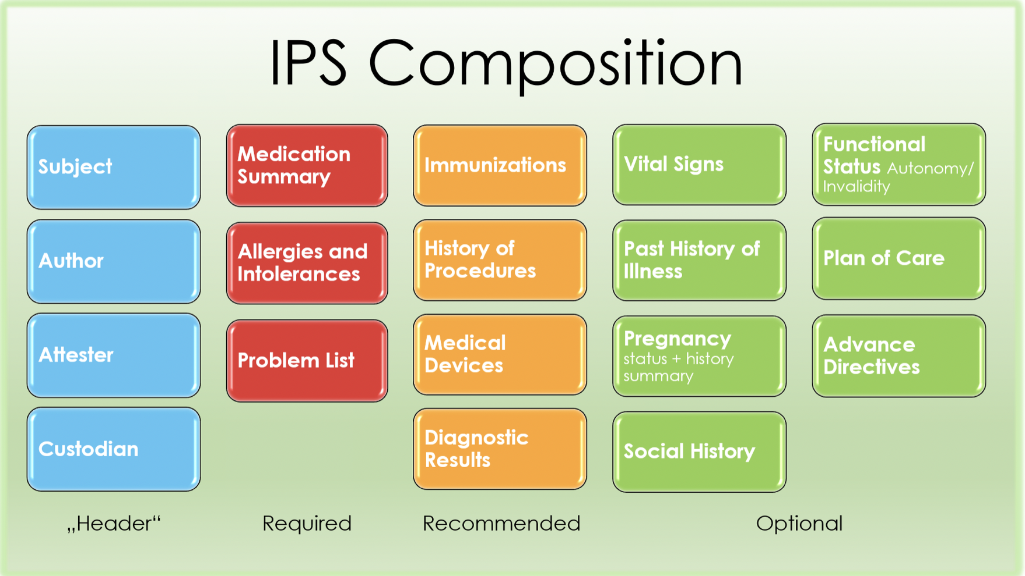
Sections IPS Brazil
This presentation describes the mapping of the Brazilian list of immunobiologics to SNOMED IPS

Slide 5
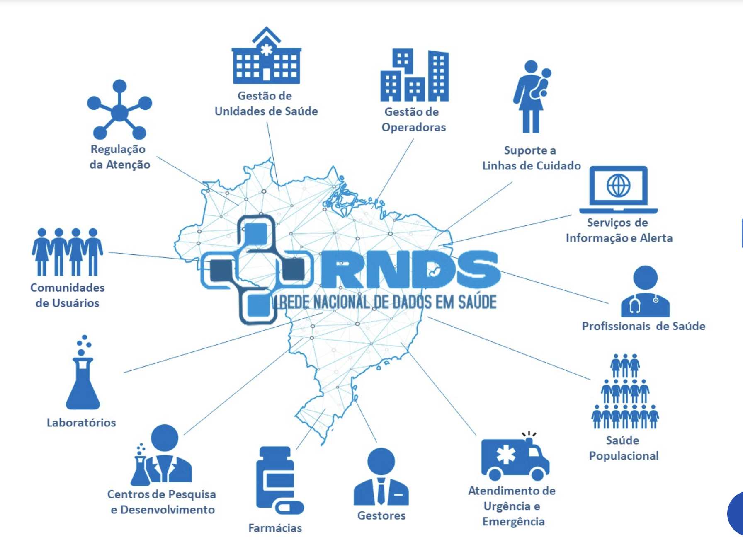
Brazilian National Digital Health Strategy
RNDS Repository actual figures (Sept/23):
The National Health Data Network (RNDS)
is the national platform for connecting all health actors. RNDS is the national platform for innovation and health services
Primary Care Units
Specialized Care and Hospitals
1.4 billion vaccines registries
> 71 million results of COVID19 lab tests
> 120 thousand outpatient encounters
Lines of care
Guidelines /Decision Support
Users Communities
Healthcare Providers
Laboratories
Population Health
R&D Centers
Urgency and
Emergency Care
Pharmacies
Pharmacies
https://www.gov.br/saude/pt-br/composicao/seidigi/rnds

Slide 6
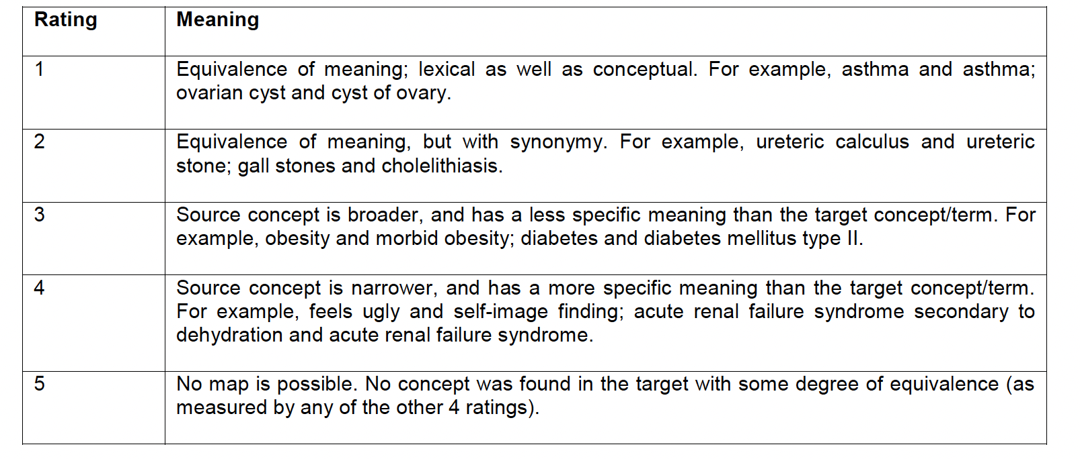
Approach
The Brazilian 103 concepts for immunization as described for RNDS https://simplifier.net/redenacionaldedadosemsaude/imunobiolgico), as well as SNOMED IPS were uploaded to an open-source terminology server (Open Concept Lab).
The ISO TR- 12300 - Health informatics — Principles of mapping between terminological systems (2) standard was followed by creating mapping tables in Excel that express the direction, cardinality, and degree of equivalence of the mapping as follows:
Source: https://www.iso.org/standard/51344.html

Slide 7
Results
The Brazilian vaccines list has 103 terms, including all the vaccines from 1975 on. Before carrying out the mappings, it was observed that from the 103 terms, 2 were duplicates terms and 12 were vaccine diluents that could be mapped to SNOMED GPS refSet 74626007-Drug Diluent with an equivalence of 4, meaning that the Brazilian terms are more specific than the SNOMED ones since the Brazilian terms specify the diluent for each vaccine.
Mapping Equivalence Degrees | Total | %
1 | 10 | 11,11%
2 | 28 | 30,77%
3 | 0 | 0,00%
4 | 31 | 34,07%
5 | 21 | 23,08%
Sub-total | 90 | 100,00%
Duplicate | 1
Diluents | 12
Total | 103
Obs: 11 concepts are present on SNOMED CT core, but not in SNOMED IPS
10 concepts are not in SNOMED CT

Slide 8
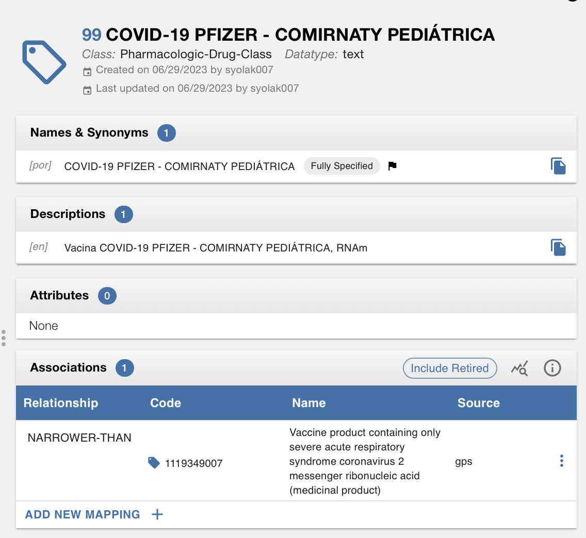

Slide 9
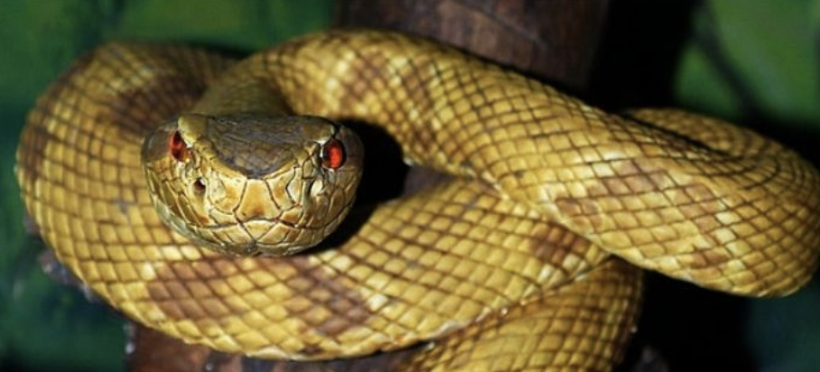
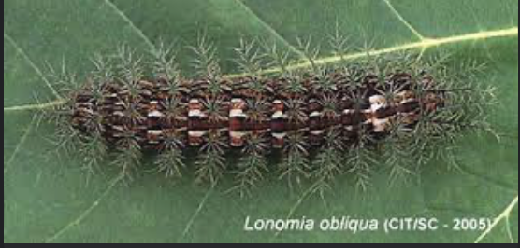
Brazilian Vaccine Codes and antivenoms not in SNOMED-CT
Brazilian Vaccine List Code | Brazilian Vaccine List PT BR | BR Vaccine List - translated | Observation
3 | Soro antiaracnídico | arachnid antivenom | 774371002- Product containing only Latrodectus mactans antivenom (medicinal product) Obs: This product is just for one type os Spider
4 | Soro antiescorpiônico | scorpion antivenom
6 | Soro antielapídico | antielapidic antivenom | Obs: SNOMED CORE has: 303306002 - Elapid venom but not the antivenom
7 | Soro antirrábico | anti-rabies serum
8 | Soro antibotrópico (pentavalente) | (pentavalent) antibothropic serum
11 | Soro antibotrópico (pentavalente) e anticrotálico | (pentavalent) antivenom for Bothrops and Crotalus snake
12 | Soro antibotrópico (pentavalente) e antilaquético | pentavalent antivenom for antilachetic snakes
31 | Soro antiloxoscélico (trivalente) | "trivalent antivenom for Loxosceles spiders
32 | Soro antilonômico | antivenom for Lonomia Obliqua
100 | Vacina Varíola Bavarian Nordic | Variola vaccine | Obs - SNOMED CORE has 713631008 - Antigen of Variola virus (substance), but no vaccine.

Slide 10
Brazilian Vaccine Codes in SNOMED-CT
Brazilian Vaccine List Code | Brazilian Vaccine List PT BR | BR Vaccine List - translated | SNOMEC CT Core concept ID | SNOMEC CT Core concept ID
2 | Soro antitetânico | tetanus antitoxin | 384706007 | Product containing tetanus antitoxin (medicinal product)
16 | Soro anticrotálico | anticrotalic serum | 777252008 | Product containing only polyvalent crotalidae antivenom (medicinal product)oduct containing only polyvalent crotalidae antivenom (medicinal product)
19 | Imunoglobulina humana antivaricela | Anti-varicella human immunoglobulin | 710704003 | Vaccine Immunoglobulin M antibody to Varicella zoster virus (substance)product containing only Human alphaherpesvirus 3 recombinant surface glycoprotein E antigen (medicinal product)|
20 | Imunoglobulina humana anti-hepatite B | Anti-hepatitis B human immunoglobulin | 122450004 | Antibody to hepatitis B virus (substance)
26 | Vacina pneumo 10 | Pneumococcal 10-valent conjugate vaccine | 1052330009 | Vaccine product containing only Streptococcus pneumoniae Danish serotype 1, 4, 5, 6B, 7F, 9V, 14, 18C, 19F, and 23F capsular polysaccharide antigens conjugated (medicinal product)
27 | Soro latrodectus | Latrodectus antivenom | 5720001 | Product containing Latrodectus mactans antivenom (medicinal product)
36 | Vacina sarampo, rubéola | Measles and rubella vaccine | 871817003 | Vaccine product containing only Measles morbillivirus and Rubella virus antigens (medicinal product)
38 | Soro antibotulínico (trivalente) | Antibotulinum serum (trivalent) | 774893001 | Product containing only botulinum antitoxin (medicinal product)
69 | Soro antibotulínico AB (bivalente) | AB antibotulinum serum (bivalent) | 774893001 | Product containing only botulinum antitoxin (medicinal product)
101 | Vacina Herpes-Zoster, recombinante | Herpes-Zoster vaccine, recombinant | 1156183006 | Vaccine product containing only Human alphaherpesvirus 3 recombinant surface glycoprotein E antigen (medicinal product)|

Slide 11

Brazil National Immunization Program (PNI)
PNI was launched in 1975 to coordinate the vaccination activities carried out routinely in the public network and became a fundamental part of the Unified Health System (SUS), established by the 1988 Constitution.
The program defines the demands for immunobiologics considering compliance with the National Vaccination Calendar
Brazil’s experience in producing vaccines:
Since 1901, Institute Butanta in São Paulo besides antitoxic and antivenom serums also produces influenza vaccines (influenza vaccine – fragmented and inactivated); DTP (diphtheria, tetanus and pertussis vaccine adsorbed); hepatitis B (adsorbed hepatitis B vaccine – recombinant); rabies in Vero cell culture (rabies vaccine – inactivated) and CORONAVAC.
institute Bio-Manguinhos in Rio de Janeiro: yellow fever, 10-valent pneumococcal, inactivated polio, oral polio, rotavirus, triple viral (measles, mumps and rubella) and tetravalent viral (measles, mumps, rubella and chickenpox) and AstraZeneca COVID-19.
Joe Droplet

Slide 12
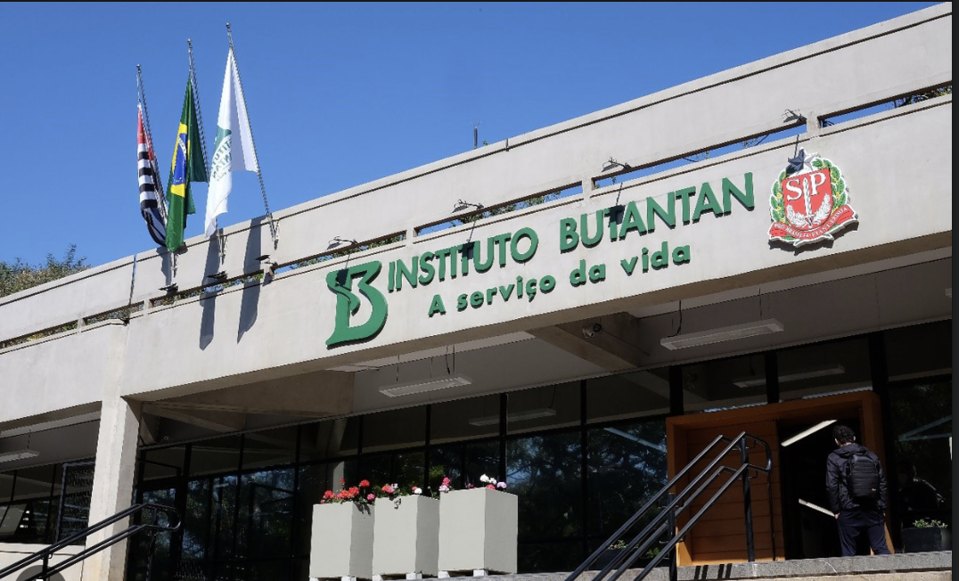
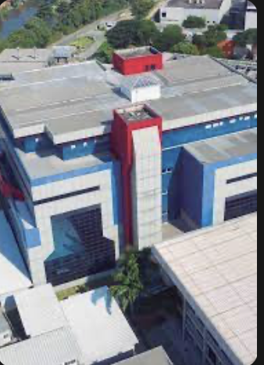
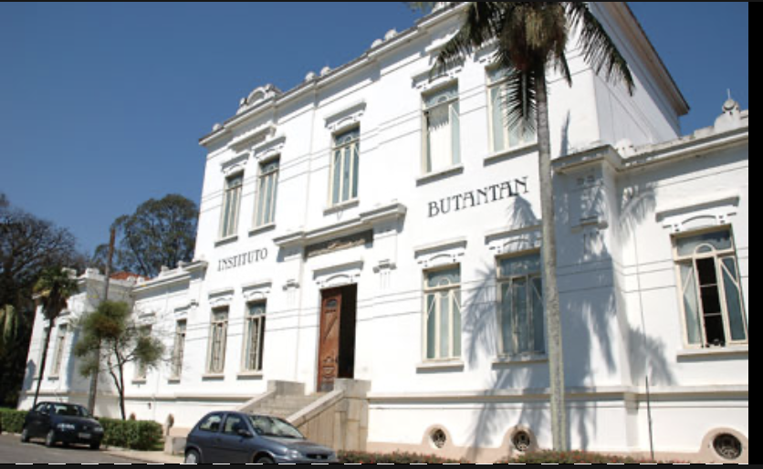
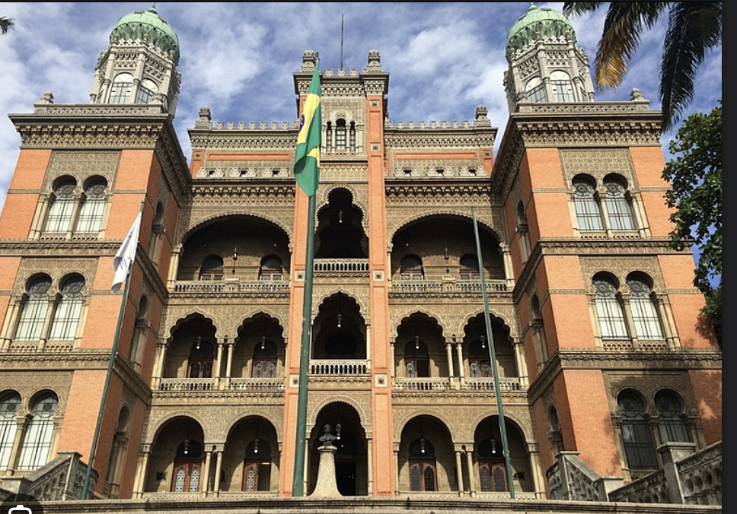
Butantan Institute, São Paulo, SP
Bio-Manguinhos Institute/Oswaldo Cruz Foundation, Rio de Janeiro, RJ

Slide 13
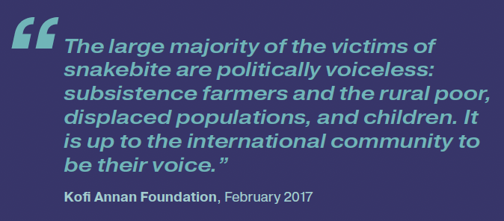

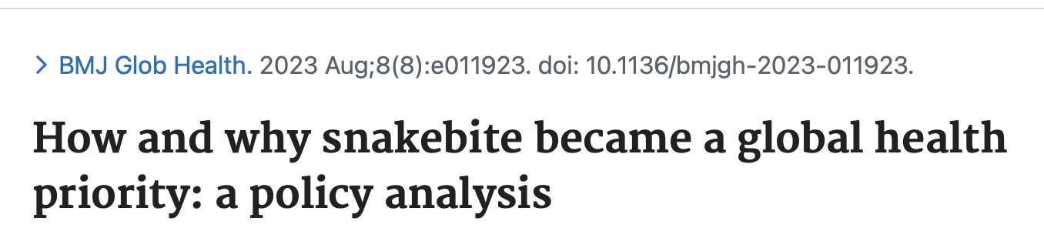
Snakebite is a global public health problem with high incidence in several countries. The WHO mentions that there are 81 000–138 000 000 global deaths due to snakebite, annually.¹ Most deaths occur in South Asia and Africa.^{2–4} In 2017, the WHO added snakebite to its list of neglected tropical diseases (NTD).⁵ ⁶This was followed by the 2018, 71st World Health Assembly (WHA) resolution (WHA 71.5) on snakebite, and the subsequent launch, in 2019, of the associated WHO strategy to halve its burden by 2030.^{2 7–}
https://www.who.int/publications/i/item/9789241515641

Slide 14
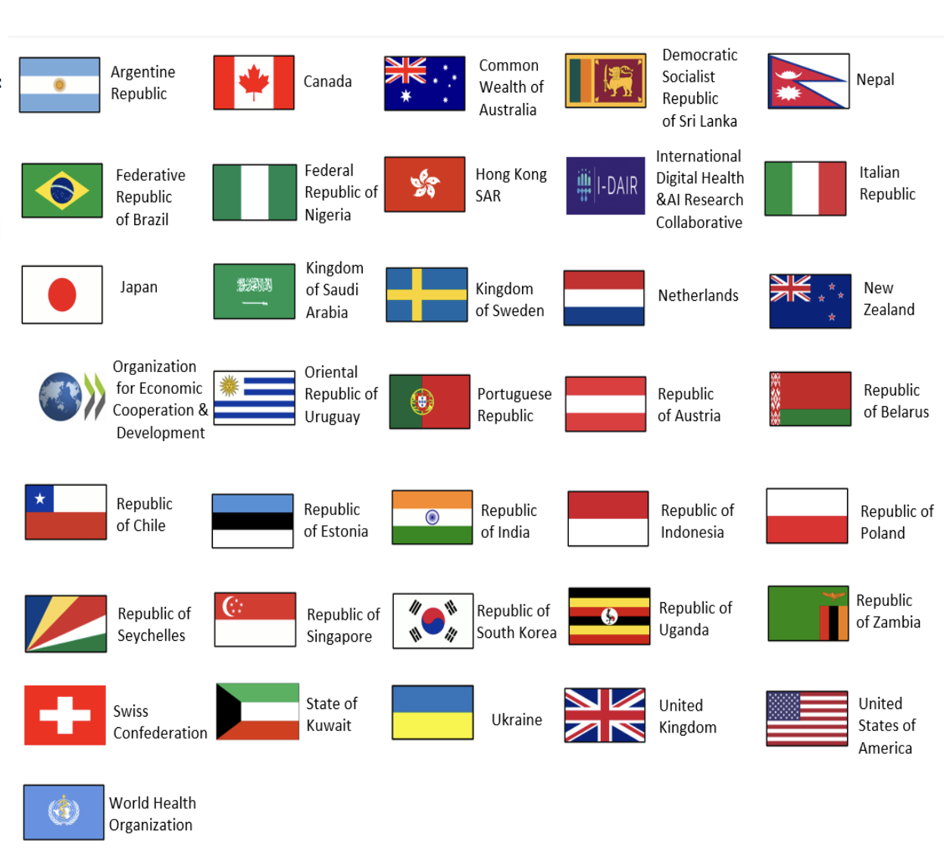
The International Patient Summary is “THE” world summary for continuity of care
The Global Digital Health Partnership was established in 2018;
Members: 6 continents // 33 countries and territories;
Representing over 2.8 billion people 3 international organizations (WHO, OECD and I-DAIR
The GDHP Interoperability Work Stream is advancing health data interoperability through the IPS Work Group.
GDHP nations are working together to strengthen the IPS, pilot the standard, and implement the IPS within their nations.

Slide 15
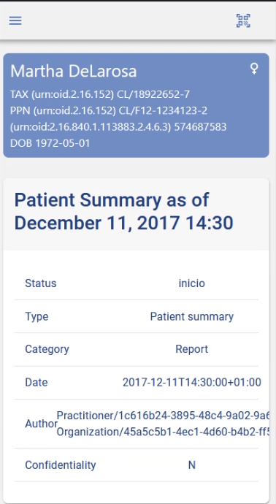
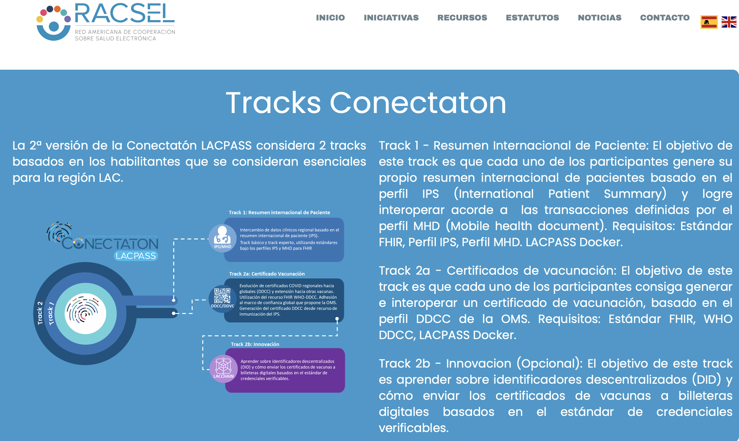
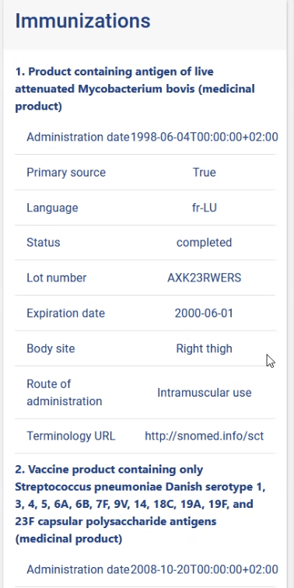
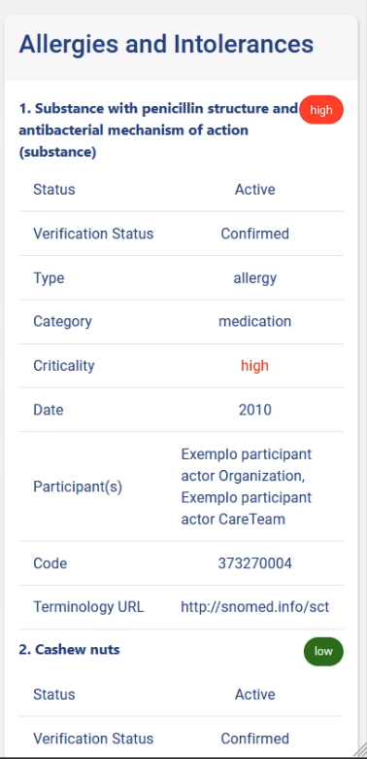
Brazilian IPS
November 12-14, São Paulo and……. we’re ready to go!!

Slide 16
Discussion
By having a patient summary in the IPS format Brazilian citizens will be able to share their relevant health data no matter where they will be in the country or abroad.
Visitors to Brazil will also be able to share their clinical information if needed
SNOMED-CT by providing the IPS refset is allowing for the sharing of relevant clinical information necessary for the international continuity of care.
It is, however, mandatory that the terms already identified by the international community of implementers of IPS that are not present today in the IPS refset, but only in SNOMED CT core are made available on the IPS subset.
In addition to that, terms that are used in specific contexts in countries and cannot be found in SNOMED today should also be included.
If SNOMED intends to be the international language for clinical interoperability it is necessary to accommodate these needs.

Slide 17


Questions/End
Thank you
Global terminology enabling quality information exchange
beatriz.leao@hsl.org.br
https://hospitalsiriolibanes.org.br/quem-somos/compromisso-social/

